Slide 1


Web Application for Maintenance Activities Sprint 1
Team 5
Antonietta Napoli
Antonella Rossi
Simona Sorgente
Angelo Vistocco

Slide 2
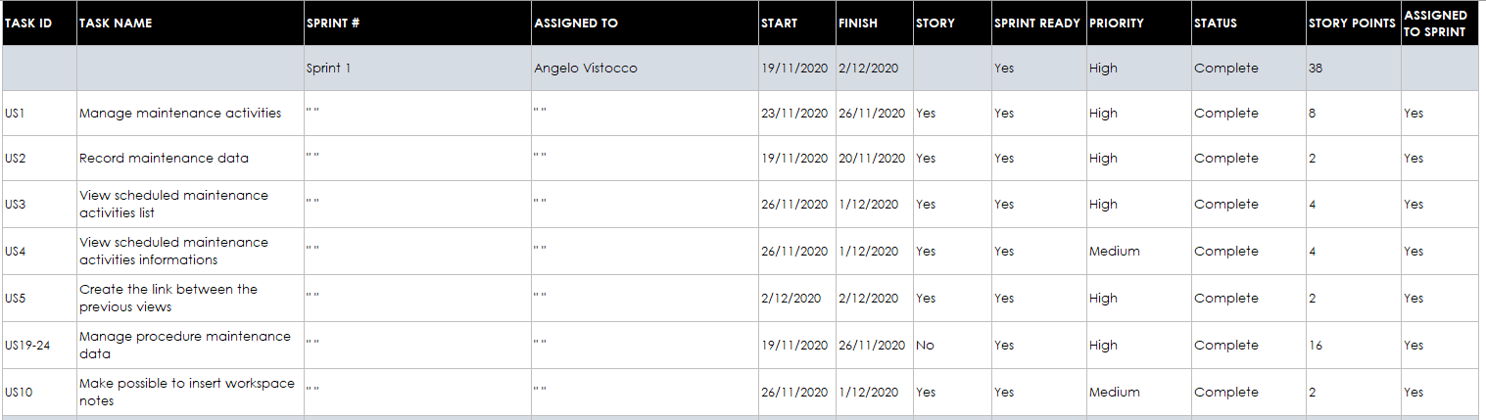
Product Backlog

Slide 3
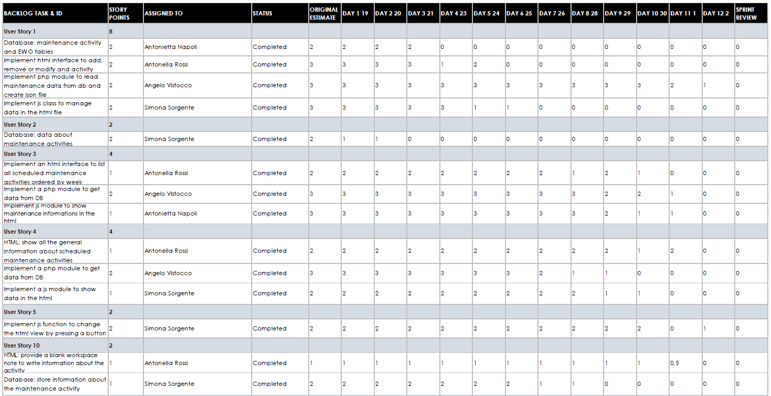
Sprint Backlog 1

Slide 4
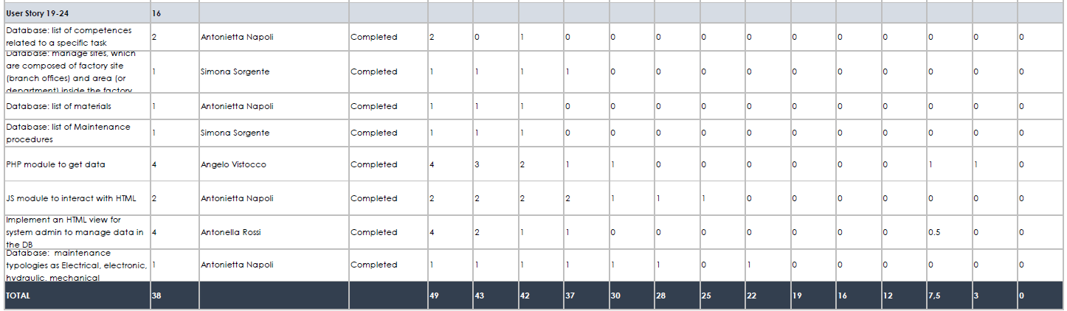
Sprint Backlog 2

Slide 5
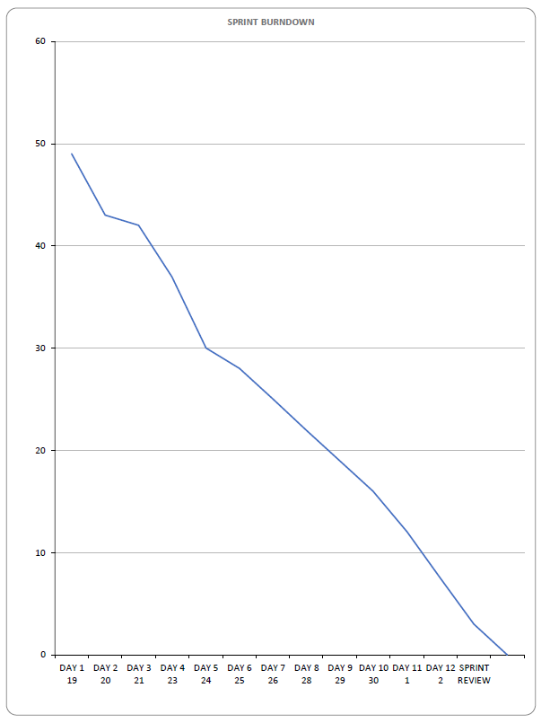
Burndown Chart

Slide 6
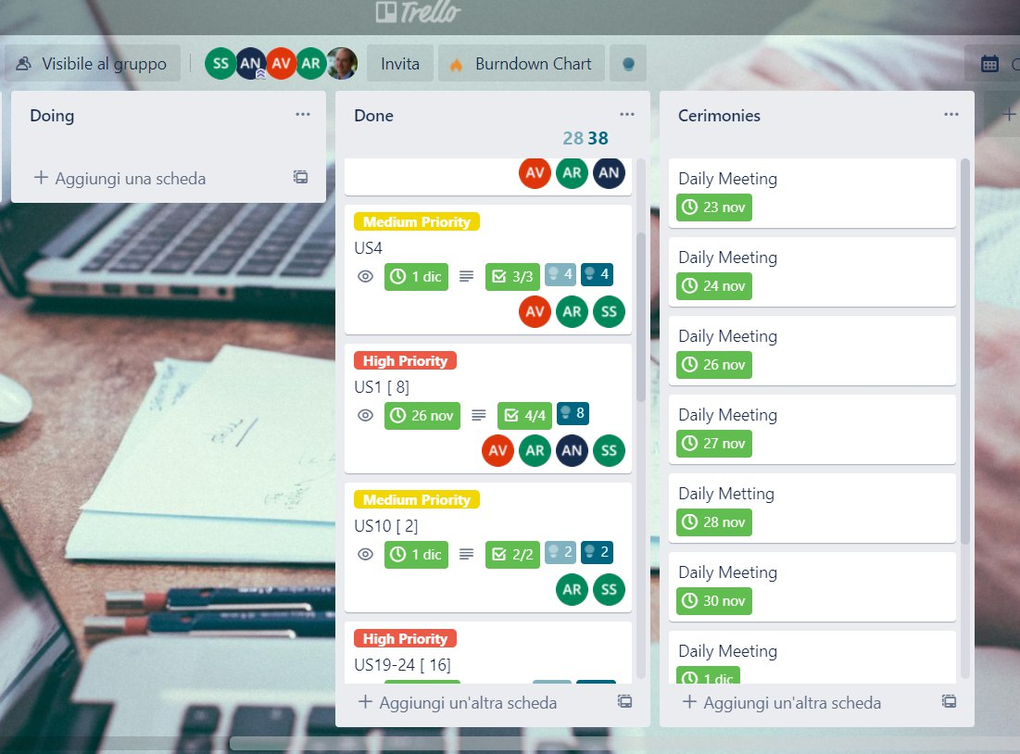
Planning with Trello

Slide 7
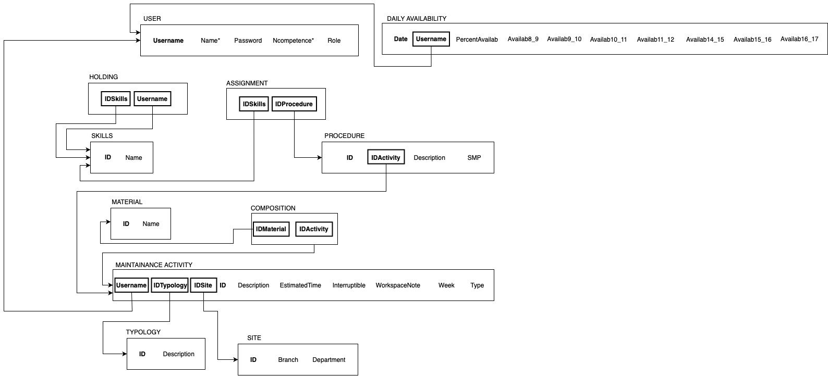
Logic Diagram

Slide 8
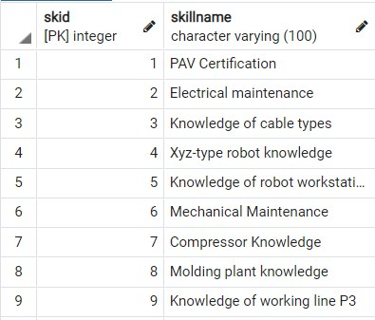
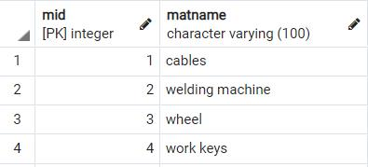
Material & Skill Tables in PostgreSQL

Slide 9

Client Views
Planner
System Administrator

